Slide 1
Centrality in Affiliation Networks
Degree Centrality:
  Graph: Active nodes (degree)
  Affiliation Net: Participation rates; event size
Eigenvector Centrality:
  Graph: Adjacent to central nodes
  Affiliation Network: Central actors are those that are members of a central event (collective); Central events (collectives) are those that have central actors
Closeness Centrality:
  Graph: Short paths to other nodes
  Affiliation Network: paths from actor to actor through events; paths from event to event through actors
Betweeness Centrality:
  Graph: Nodes that mediate flows
  Affiliation Network: central event which is the only way actors can meet; central actors that provide the only connection between events (collectivities)
Galois Lattices and set overlaps

Slide 2
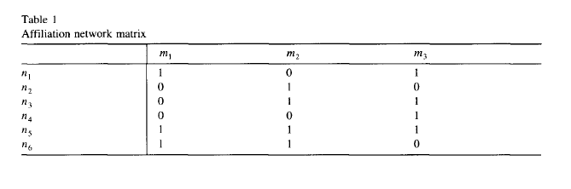



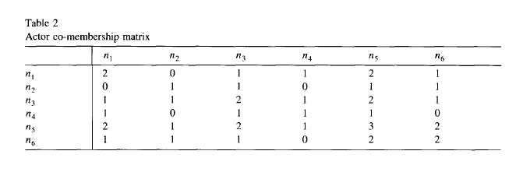


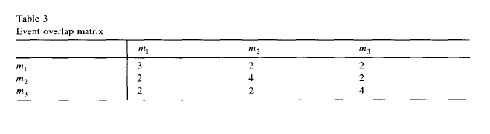

Degree Centrality
Notes:
(1) Number of non-zero off-diagonal entries in row of T2 gives number of distinct actors with which the actor shares any event in common (no double counting)
This quant. equals sizes of events an actor belongs to.
Extend this using value counts. Then sum of row counts. What is this? Contract net through events actor participates in, allowing double counting. THIS EQUALS SUM OF SIZES OF EVENTS TO WHICH ACTOR BELONGS
Not count diagonal, then this number is a function of (a) number of events an actor participates in and (2) size of these events
Compaer n1 and n2
n1: sum = 7 (or 5); n1 in m1 and m3, and their sizes are 3 and 4 = 7 (NOTE OVERLAP) ---- degree of n1 is a function of both # events n1 in AND size of those events
n2: sum = 4 (or3); n2 in only m2, its size is 4 (3 if not count n2). N2 is low centrality because in only 1 event even though that event is fairly big
OVERLAP LEADS IT LATTICES
FOR EVENTS:
NON-ZERO non-diag in row for event overlap is number of distinct overlaps (2)
Using countrs, sum of event overlap matrix rows (e.g., 7) is total participation levels of actors that belong to that event (i.e. sum of their size)
e.g., m1 sum is 7: M1 has actors n1 n5 and n6 in it, and these three actors belong to 2, 3, and 2 events, which totals to 7
SO THIS IS SUM OF THE MEMBERSHIP “DEGREES” OF THE ACTORS THAT ARE IN THAT EVENT. Means that centrality of event is a function of its size and the “connectedness” of its members (i.e. their paritcipation rates).
CENTRAL actors are those that belong to more collectives that are larger
Central events (collectives) are those that have members who belong to more collectives.
Degree of an actor in an affiliation net is the number of other actors it can connect to through events that it participates in.
The more events it participates in, the higher its degree
The more the events it participates in are large (ARE CENTRAL – Eigenvector), the higher its degree.
Degree of an event in an affiliatin net is the number of other events that it is connected to through actors that are members of the event.
The more members an event (coll.) has, the higher an event’s degree
The higher the participation rates (degrees OR EIGENVECTOR CENTRALITY) of the members of an event, the higher an event’s degree is.
*

Slide 3
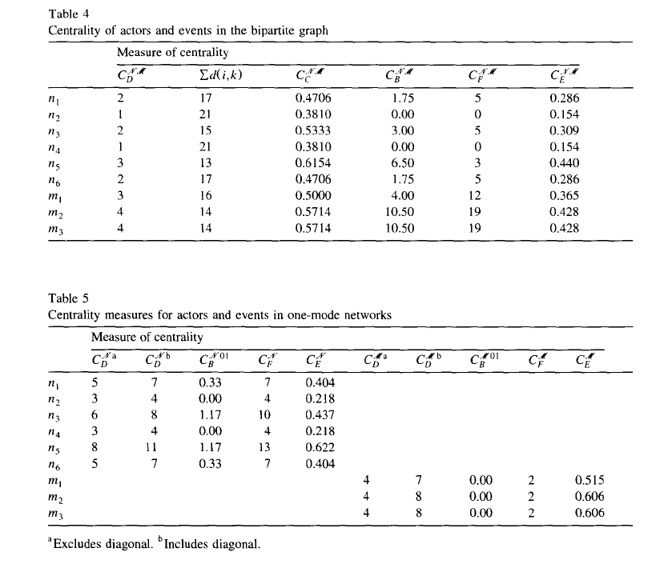

Slide 4
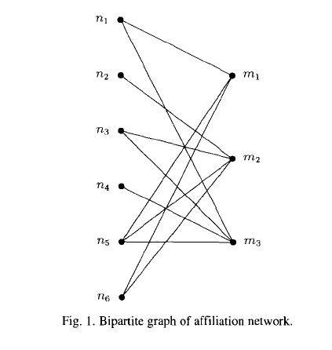

Slide 5
Eigenvector Centrality
The Centrality of an actor is proportional to the centralities of the events it is affiliated with
The centrality of an event is proportional to the centralities of its members
Problem: Actors that belong to one event and events that only have one member can have non-zero eigenvector centrality
Notes:
Problem – they are problem because they can not by definition link anyone.
*

Slide 6
Closeness Centrality
Distances between
  Actor and other actors
  Actor to all events
For an actor closeness centrality is a function of minimal distances from
  any of its events to other actor
  any of its events to other events
For an event, closeness centrality is a function of minimal distances from
  its actors to other actors
  its actors to other events
Notes:
Look at Sum d(i,k) n2 vs. n5
*

Slide 7
Betweeness Centrality
Actors always on geodesics between events
Events always on geodesics between actors
An event gains betweeness centrality when pairs of its members only meet through that event (i.e. its actors belong to no other events)
An actor gains betweeness centrality when it is the only actor that is affiliated with a pair of events (i.e. the actor is the only member of the event)
Notes:
For an event: irony, if most members not in any other events, higher betweeness centrality, i.e. non-central actors create high event betweeness centrality
For an actor, if it belongs to an event with only one member (it), the actor gains betw centrality
LIKE actors bridge events and have more centrality to the extent that only they do so
events bridge actors and more more centrality to the extent that only the event does so
Events: Look at n2 to n6, must go through M2, which gives M2 higher centrality
Actors: Look at N5 vs. N4 (or N2).
N5 connects all three events, while N4 and N2 connect none (because they only belong to one event).
*

Slide 8
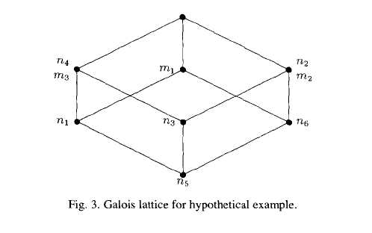
Galois Lattices and Overlap
Events a sets of actors
Actors are sets of events
Ascending lines connect actors to subset of events it is affiliated with
Descending lines connect connect each event to actors that it is affiliated with
Lines connecting actors (events) indicate subset relations
Lower actors in diagram are more central
Higher events in diagram are more central
Notes:
Subsets. For example n5 set (m1, m2, m3) covers n3 (m2, m3) , which covers n4 (m3) and n2 (m2)
In this case no overlaps among events
*

